Slide 1
Week 7
Abstraction
Abstract sketch starter
Identifying elements of composition
How do abstract paintings transmit emotion?
Balance and tension
Using still life elements for effect.
Next week. Painting the human figure

Slide 2
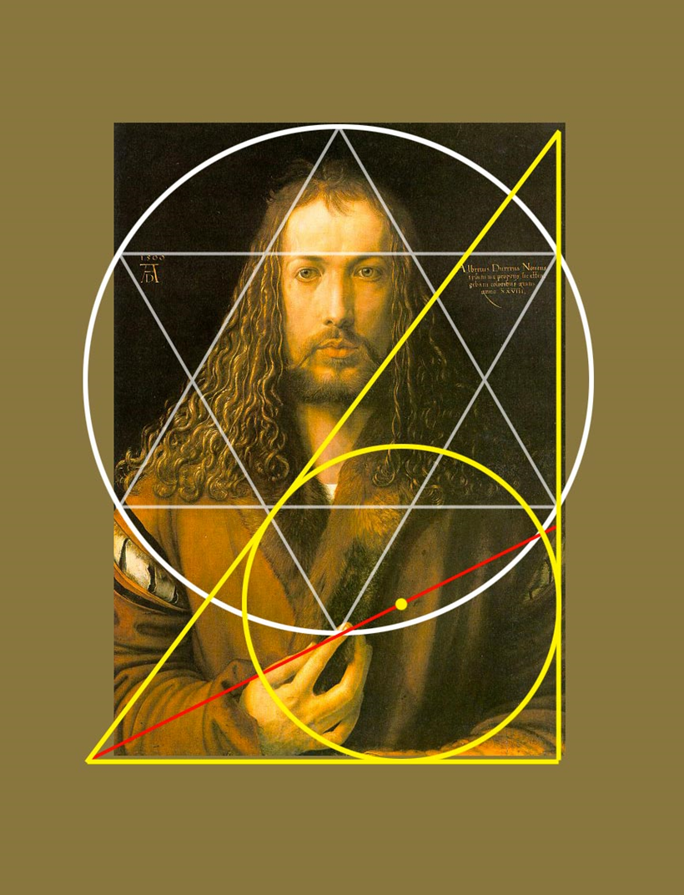

Slide 3
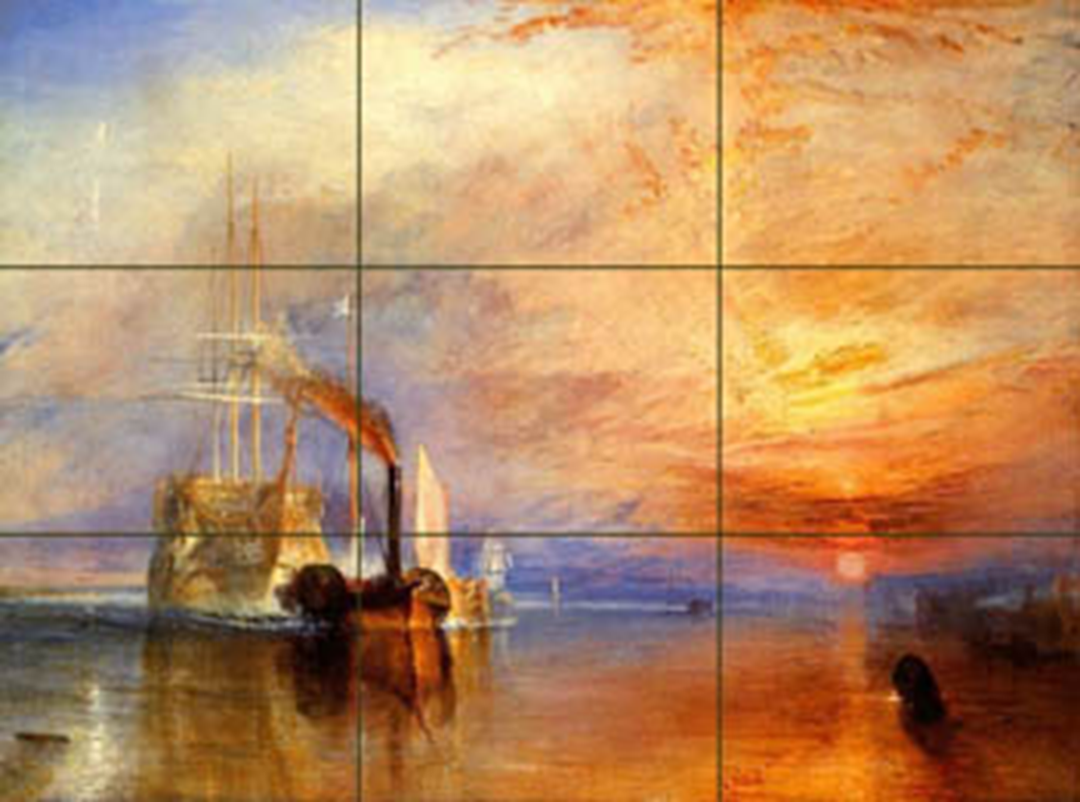

Slide 4
Rembrandt

Slide 5
Bruegel the Elder

Slide 6
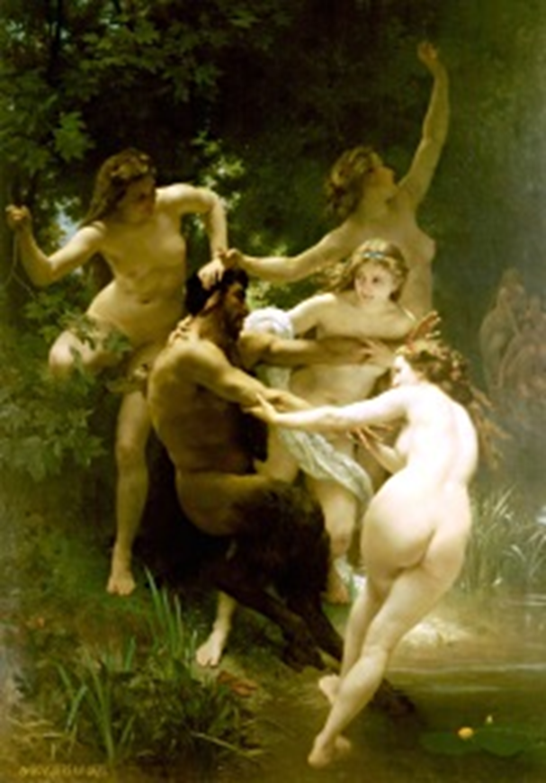

Slide 7
Goya

Slide 8
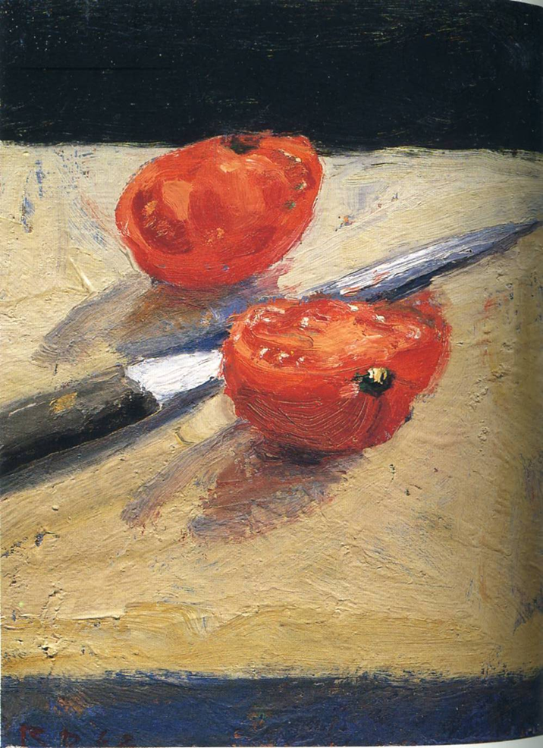
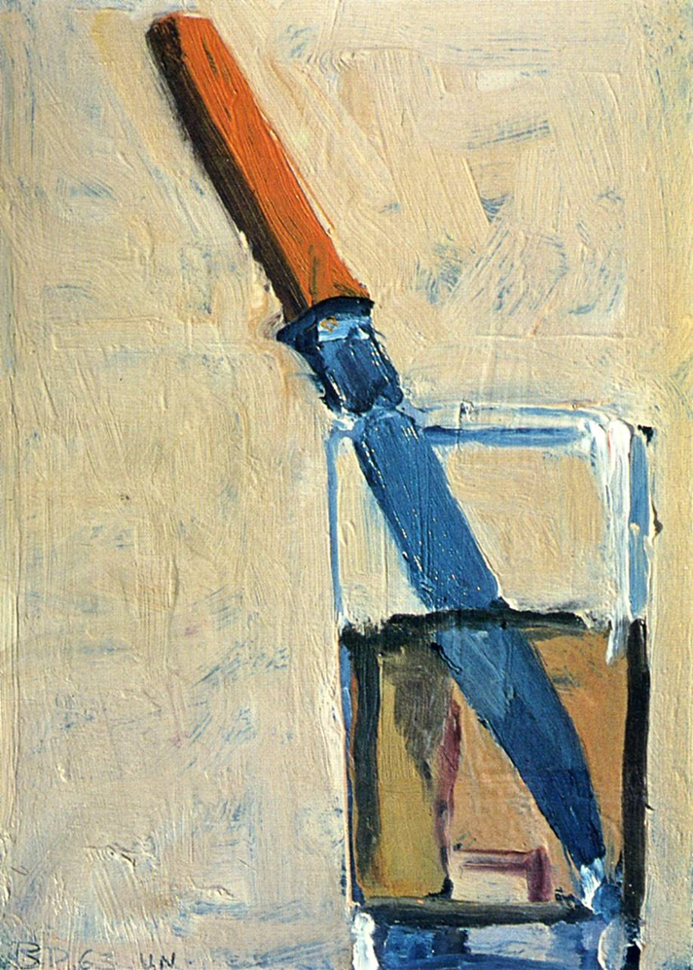
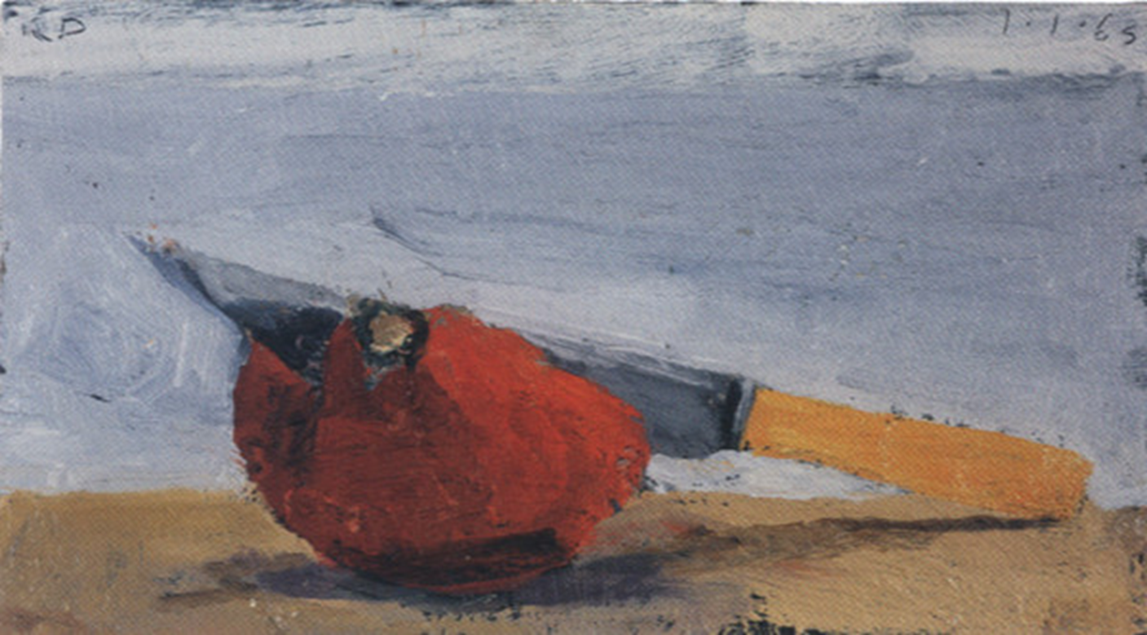
Richard Diebenkorn

Slide 9
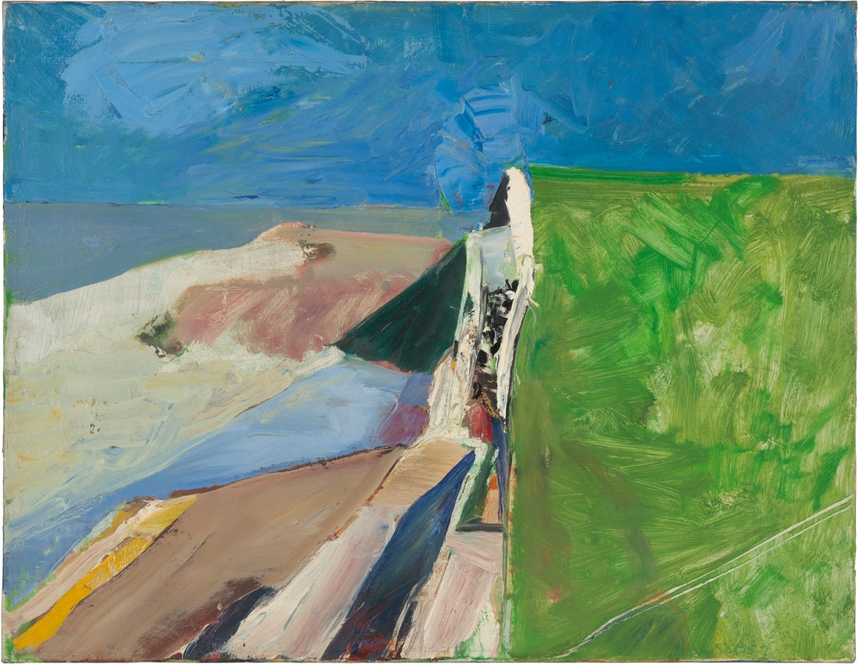

Slide 10
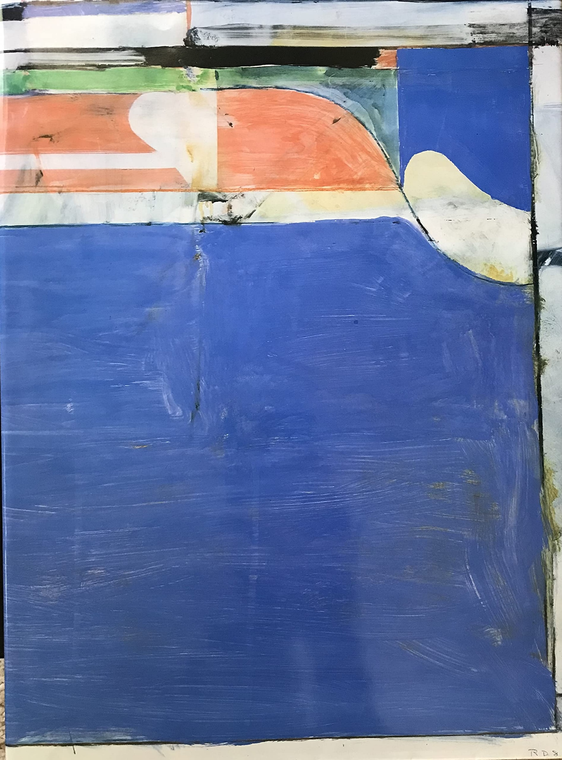

Slide 11
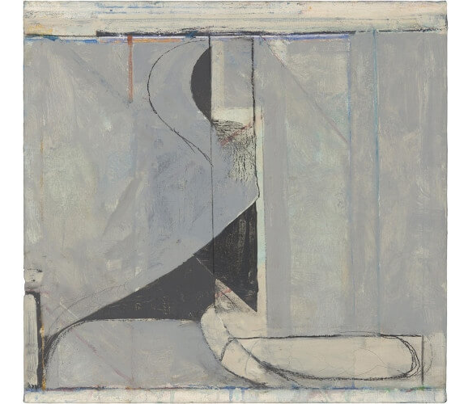

Slide 12
