Slide 1
COAS painting course Mondays intermediate/advanced Thursdays beginner/intermediate
January to March 2022
Sebastian Aplin

Slide 2
Covid regulations
Maintain 2 mt. distance
Wear a mask at all times
Keep windows open for ventilation
No eating or drinking in life model room
Don’t share material
Wash hands frequently

Slide 3
Topics:
Painting materials and organisation
Painting process and mentality
Painting movements and styles
Critical language
Subject matter:
Still life
Interiors
Resource images
Theory:
Colour constancy, harmony
Hue and value
Composition
Psychology of looking
Abstraction of forms
Modelling with light
Mechanisms:
Volume, depth and distance
Figure/ground relationship
Observation
Positive and negative space
Relative contrast
Outlines and simplification

Slide 4
Structure of classes
Presentation of theory/mechanism
Practice demonstration and warm up
Images of contemporary/historical work
Discussion and painting task
Individual feedback
Informal crit/ group review/ weekly h/w
Blog exercises and preparation/questions and comments

Slide 5
Painting materials and equipment
Easels, boards and paper
Materials use and disposal
Cleaning brushes and equipment
Build up your material stock to suit your needs

Slide 6
Week 1
Identifying outlines (silhouettes)
Sketching using 2 and 3 values
Using viewfinders for composition
Negative space chairs
Figure/figure ground relationship

Slide 7
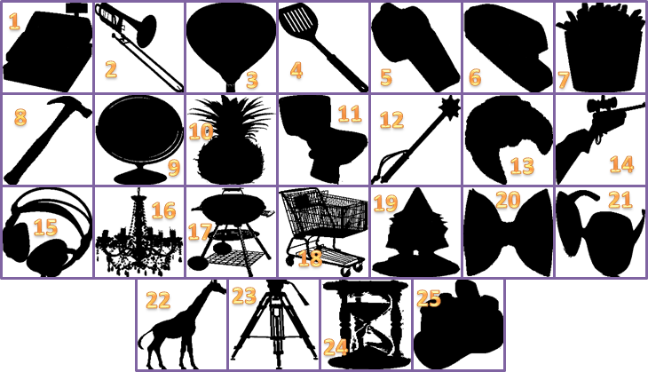
Recognising negative images (silhouettes)

Slide 8
Low to high values

Slide 10
Contrasting values

Slide 12
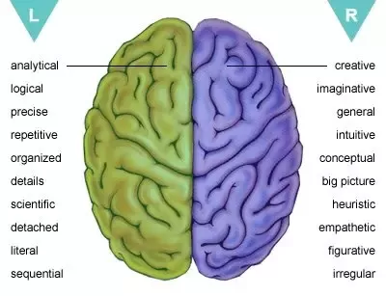
Examples of right/left brain activity

Slide 13
Negative image
Betty Edwards. Drawing on the right side of the brain

Slide 14
Magritte

Slide 15
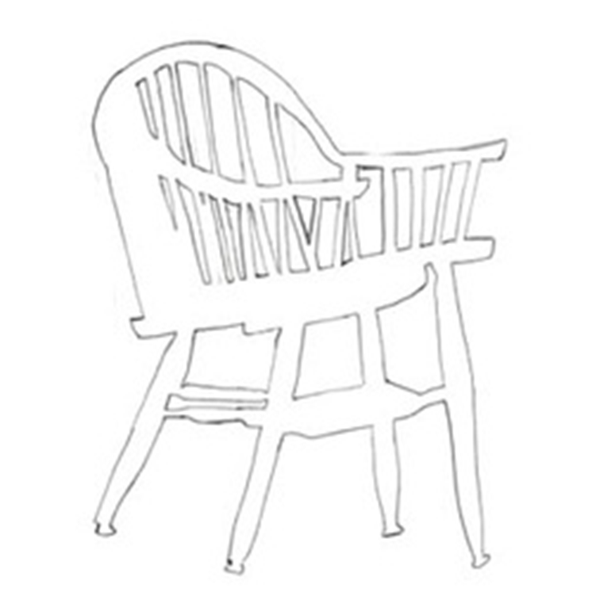
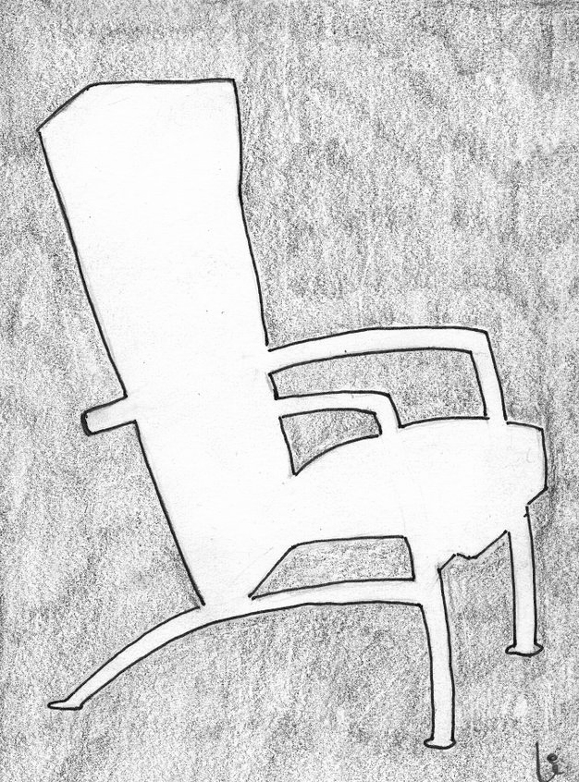
Negative Space

Slide 16
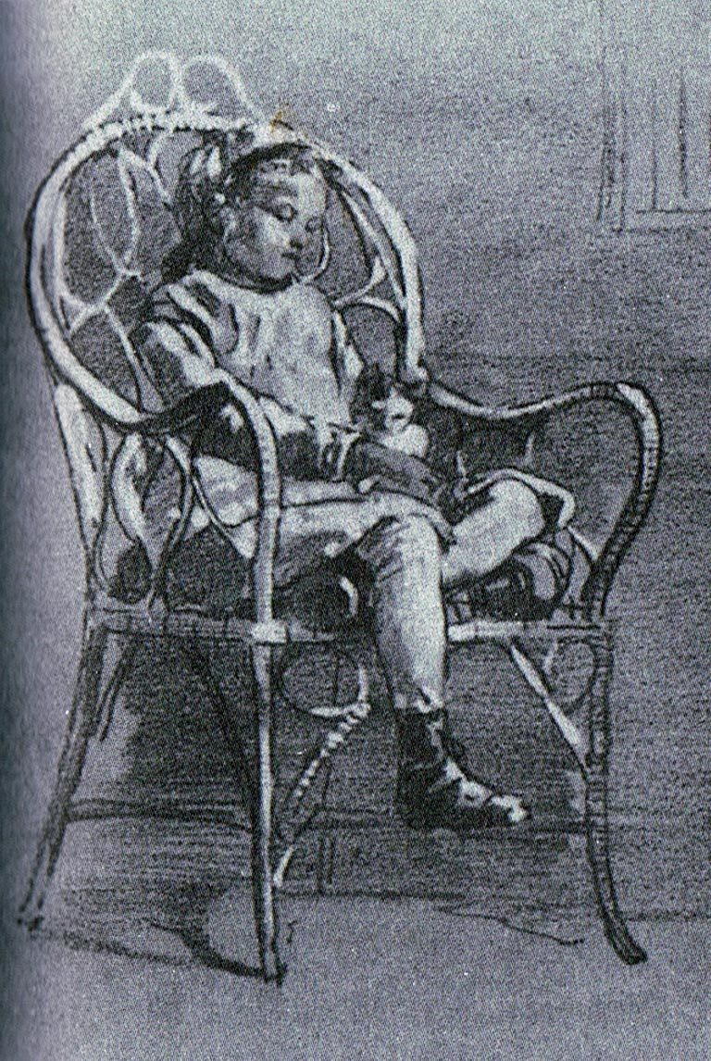
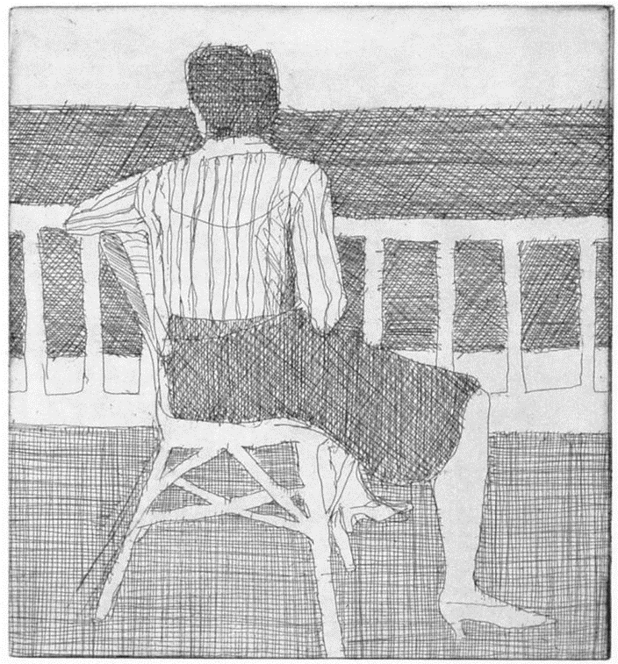
Richard Diebenkorn
3 value study

Slide 18
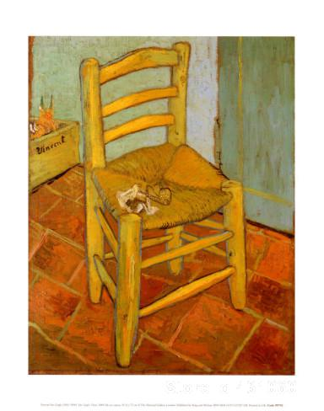
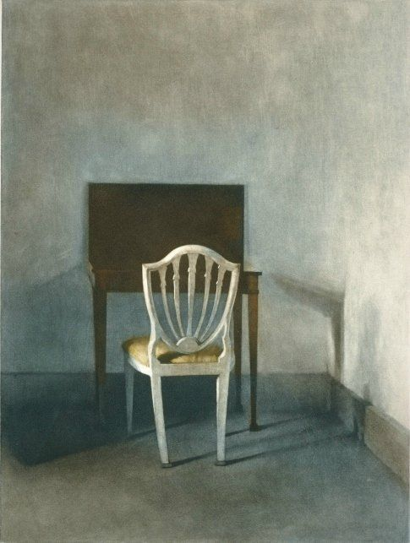
Van Gogh and Hammershoi

Slide 19
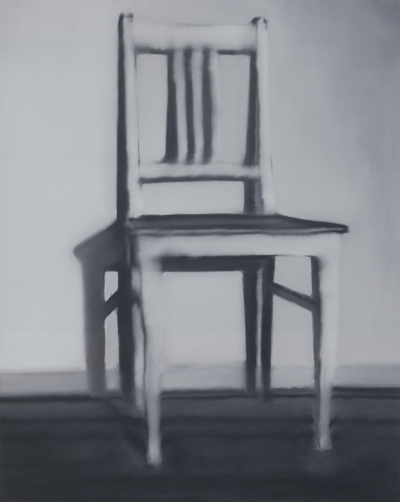
Andy Warhol and Gerhard Richter

Slide 20
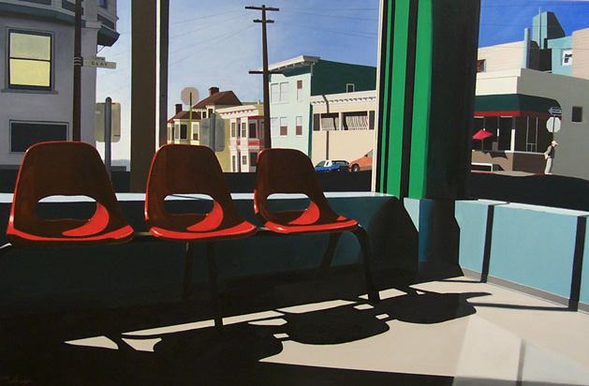
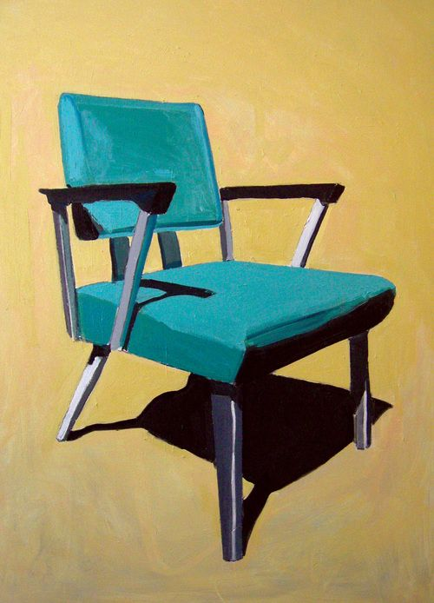
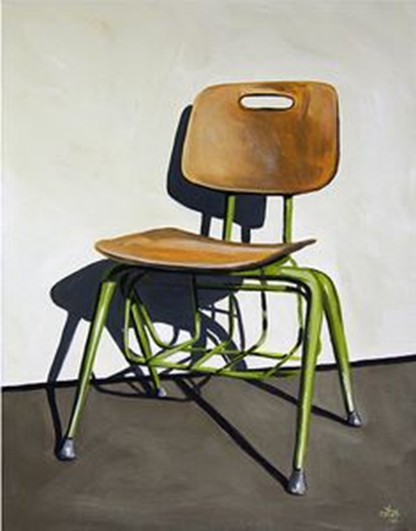
Matt Condron, Christopher Scott and Jessica Brill

Slide 21
H/W. Use viewfinder to sketch or paint negative shapes
Post any sketches and comments under this week’s blog post
Session 2
How light affects colour
Check blog post for any preparation reading!

Slide 22
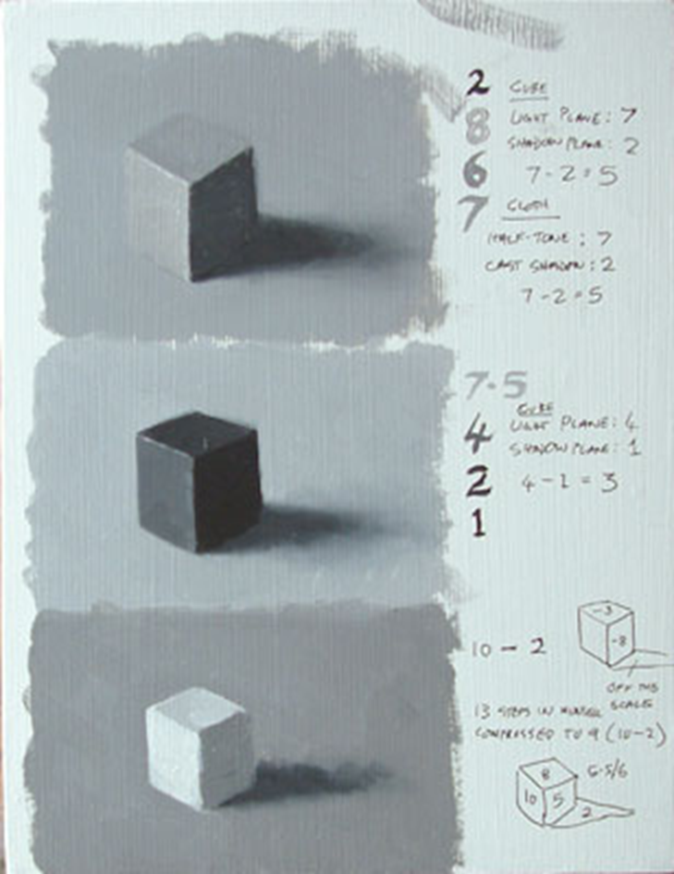
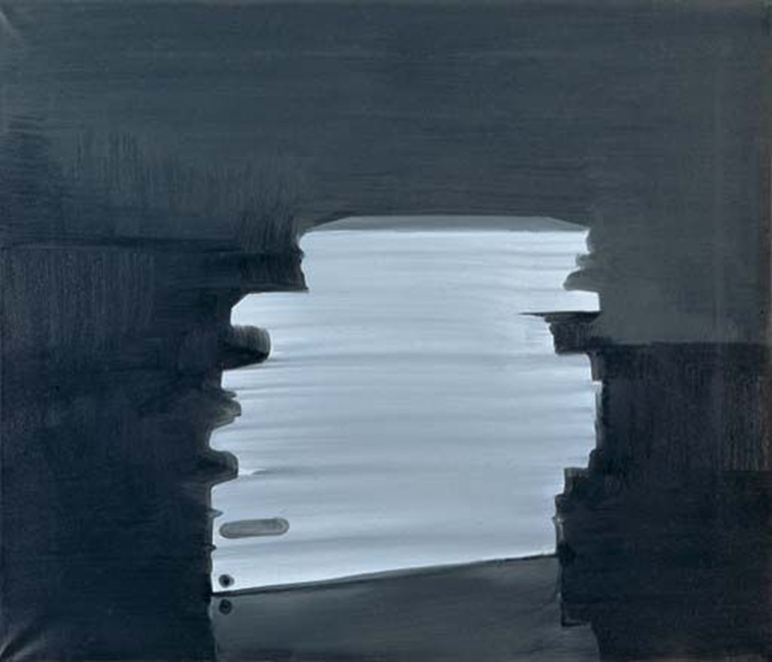
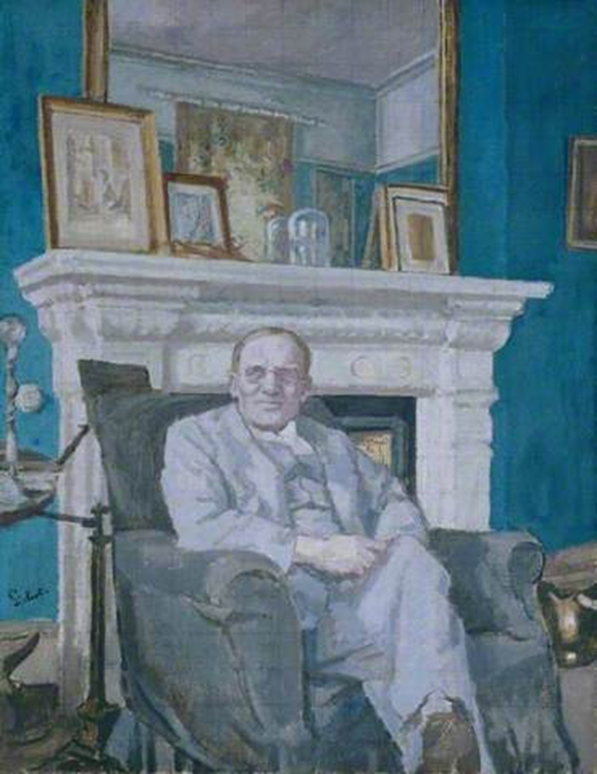
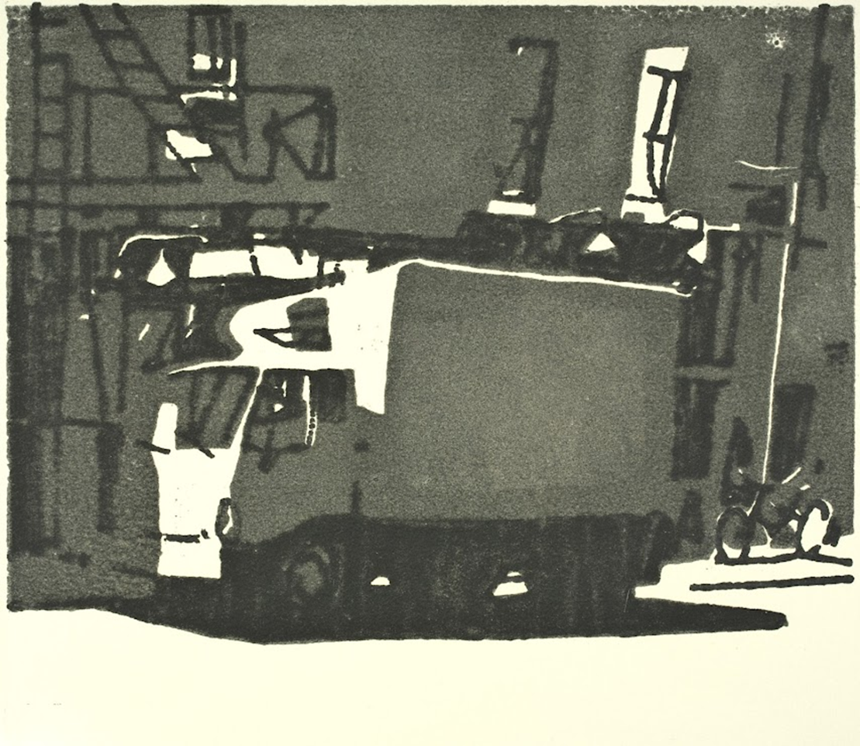
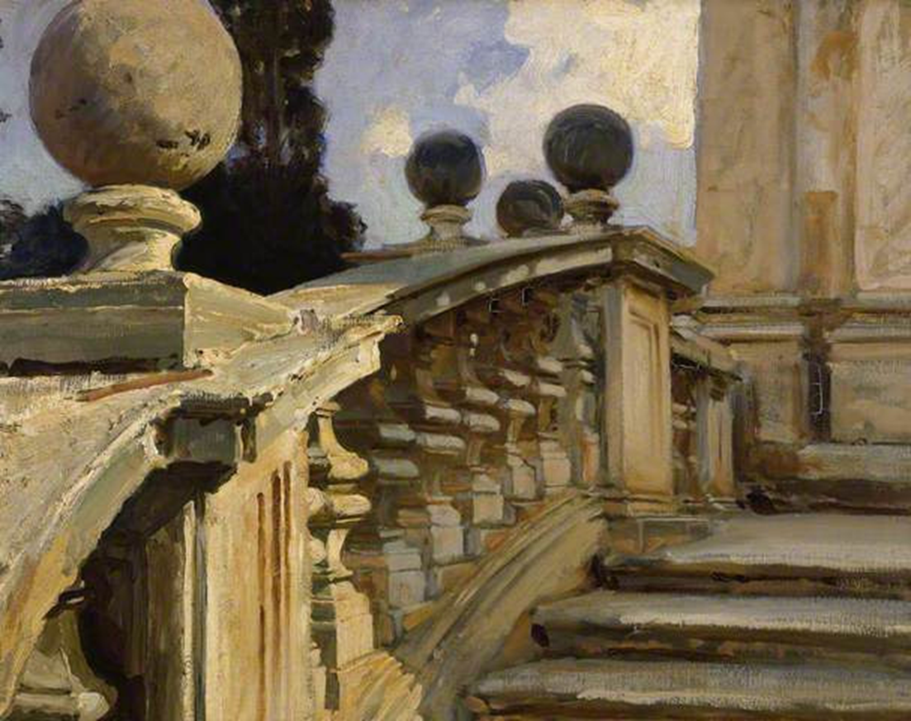
Key terms
Modeling
Form with light
Negative space
Outline
Relative contrast
Value scale
Simplification

